Slide 1
SBA 1st First Wednesday Virtual Learning 2017
“Contract Bundling”

Slide 2
Hosts
Jan Kaiser, Procurement Center Representative
SBA Office of Government Contracting, Area IV, Chicago
janis.kaiser@sba.gov
(312) 353-7442
Deborah Crumity, Procurement Center Representative
SBA Office of Government Contracting, Area IV, Rock Island Arsenal
deborah.d.crumity.civ@mail.mil
(309) 782-5734

Slide 3
Welcome to “SBA Virtual Learning 2017”
Questions answered during the final 10 minutes.
Technical problems: Contact the moderator with a note or call AT&T Connect Support at 1-888-796-6118.
Page numbers stated for those working off hard copies of the program.
We cover the “SBA Quick Reference” as time allows.
For more SBA training visit the SBA Learning Center website https://www.sba.gov/tools/sba-learning-center/search/training

Slide 4
Association of Procurement Technical Assistance Centers posts past “First Wednesday” programing
Check this link for past programs:
http://www.aptac-us.org/for-contracting-officers- sba-webinar-library/
Contracting officer resources: “How PTACs partner with federal agencies”:
http://www.aptac-us.org/federal-partners/
Find your nearest Procurement Technical Assistance Center at http://www.aptac-us.org

Slide 5
FIRST WEDNESDAY VIRTUAL LEARNING SERIES – 2017 SCHEDULE 9:30 to 10:30 Central Time
FY 2017 | Date | Topic
1 | October 5, 2016 | Non-Manufacturer Rule
2 | November 2, 2016 | Market Research: Using FPDS & DSBS
3 | December 7, 2016 | New All SB Mentor-Protégé Program
4 | January 11, 2017 | SBA Surveillance Reviews 2017
5 | February 1, 2017 | Certificate of Competency Program
6 | March 1, 2017 | Historically Underutilized Business Zones
7 | April 12, 2017 | Subcontracting Plan Compliance
8 | May 3, 2017 | Woman Owned Small Business
9 | June 7, 2017 | Size and Affiliation
10 | July 12, 2017 | Consolidation and Bundling
11 | August 2, 2017 | 8(a) Business Development
The program schedule above is for information only and is subject to change.

Slide 6
One Continuous Learning Point
Self-service: Using the PowerPoint that was sent with your invitation for this training event, fill in your name on the certificate slide and save. Download the certificate and print for your records. You submit your request for training credit IAW your agency policy, i.e. FAITAS.
Phoning in only: If you listen in groups and you want all attendees to be included on the future mailing list, send email addresses of participants in an excel document to sbalearning@sba.gov.

Slide 7
Certificate of Training
“SBA 1st Wednesday Virtual Learning 2017”
This Certificate is awarded to
Insert Your Name Here
For completion of
“Contract Bundling”
This training seminar may be credited towards “Continuous Learning Points” as described in OFPP Policy Letter 05-01. Recommendation of One CLP.
7/12/2017
Pamela J. Beavers date
Director, Area IV
SBA Office of Government Contracting

Slide 8
Contract Bundling Mr. Michael McLaughlin Assistant Director, Office of Policy and Research Small Business Administration
First Wednesday| July 12, 2017 |

Slide 9
Discussion Topics
References
Definitions
Pre-Award Acquisition Requirements
Documentation
Notification
Post-Award Requirements
Congressional Report
Scenarios and Recommended Best Practices

Slide 10
References
FAR Part 2: Definitions of Words and Terms
DFARS Part 205: Publicizing Contract Actions
FAR / DFARS Part 7: Acquisition Planning
FAR Part 8: Federal Supply Schedules
FAR / DFARS Part 10: Market Research
FAR Part 15: Contracting by Negotiation
FAR Part 16: Types of Contracts
FAR / DFARS Part 19: Small Business Programs
13 C.F.R 125.2

Slide 11
Bundling vs Consolidation

Slide 12
Consolidation
Soliciting a single contract (including MACs) to satisfy two or more requirements for supplies or services valued in excess of $2M that have been provided to or performed for the Federal Agency under two or more separate contracts lower in cost than the contract for which offers were solicited OR
To satisfy requirements of a Federal Agency for construction projects to be performed at two or more discrete sites.

Slide 13
Bundling
Consolidating two or more requirements for supplies or services, previously provided or performed by a small business under separate small contracts, into a solicitation for a single contract (including MACs) that is likely to be unsuitable for award to a small business concern

Slide 14
Substantial Bundling
DoD
any bundling whose estimated contract or order value is $8M or more
NASA / GSA / DoE
$6M or more
Other Federal Agencies
$2.5M or more

Slide 15
Acquisition Planning Requirements
FAR 7.103(u): Agency-Head is responsible for ensuring that acquisition planners, to the maximum extent practicable,
Structure contract requirements to facilitate competition by and among SB concerns and
Avoid unnecessary and unjustified consolidation or bundling

Slide 16
Acquisition Planning Requirements
FAR 7.104(d): Planner coordinates acquisition plan/strategy with SB specialist for acquisition meeting threshold for substantial bundling. SB specialist notifies Agency OSBP/OSDBU if bundling is unnecessary/unjustified or the bundled or consolidated requirement is not identified as such
FAR 7.105(b): Acquisition plan must consider impact of consolidation/bundling for acquisition; if bundled, must identify incumbent contractors and contracts affected.

Slide 17
Acquisition Planning Requirements: Consolidation
FAR 7.107-2(a): Agencies shall not consolidate contract requirements with an estimated total value exceeding $2M unless the agency:
Conducts adequate market research
Identification of any alternative contracting approaches that would involve a lesser degree of consolidation;
Makes a written determination signed by the SPE that is coordinated with the OSDBU/OSBP that the consolidation is necessary and justified
Identify any negative impact on small business concerns
Ensure steps will be taken to include small business concerns

Slide 18
Acquisition Planning Requirements: Consolidation
FAR 7.107-2(b): Market Research must demonstrate that the benefits of the acquisition strategy substantially exceed the benefits of each of the possible alternative contracting approaches.
FAR 7.107-2(c): Benefits may include cost savings or price reduction and, regardless of whether quantifiable in $ amounts
Quality improvements (save time or improve/enhance performance/efficiency
Reduction in acquisition cycle times
Better terms and conditions or
Any other benefit

Slide 19
Acquisition Planning Requirements: Consolidation
FAR 7.107-2(d):
Quantifiable ($) benefits that individually or combined lead to benefits equivalent to
If the award value is $94M or less: 10% savings
If the award value is greater than $94M
$9.4M or 5% of the award value (whichever is greater)
Non-quantifiable ($) benefits must be identified and quantified to the extent feasible
Administrative cost savings alone are considered to be substantial alone if they are at least 10%.

Slide 20
Acquisition Planning Requirements: Bundling
FAR 7.107-3(a): MR must demonstrate that the agency would obtain measurably substantial benefits as compared to meeting its agency’s requirements through separate smaller contracts or orders.
FAR 7.107-3(b): Agency must quantify specific benefits identified through MR and other techniques
FAR 7.107-3(c): Benefits may include cost savings, price reduction
Quality improvements (save time or improve/enhance performance/efficiency)
Reduction in acquisition cycle times or
Better terms and conditions.

Slide 21
Acquisition Planning Requirements: Bundling
FAR 7.107-3(d) Quantifiable ($), measurable, substantial benefits that individually or combined lead to benefits equivalent to
If the award value is $94M or less: 10% savings
If the award value is greater than $94M
$9.4M or 5% of the award value (whichever is greater)
Administrative convenience alone can be classified as cost savings alone are considered to be substantial alone if they are at least 10%.

Slide 22
Acquisition Planning Requirements: Substantial Bundling
FAR 7.107-4(b): When the proposed acquisition strategy involves substantial bundling, the acquisition strategy must additionally:
Identify the specific benefits anticipated to be derived from bundling;
Include an assessment of the specific impediments to participation by small business concerns as contractors that result from bundling;
Specify actions designed to maximize small business participation as contractors, including provisions that encourage small business teaming;

Slide 23
Acquisition Planning Requirements: Substantial Bundling
FAR 7.107-4(B) (cont):
Specify actions designed to maximize small business participation as subcontractors (including suppliers) at any tier under the contract, or order;
Include a specific determination that the anticipated benefits of the proposed bundled contract or order justify its use; and
Identify alternative strategies that would reduce or minimize the scope of the bundling, and the rationale for not choosing those alternatives

Slide 24
Bundling Notification Requirements
Notification | Incumbent SBC | SBA PCR | FBO | FBO (Annually) | SB Specialist*
Initial | X | X | X | X | X
 | 30 days prior to solicitation | 30 days prior to solicitation | Rationale : Before issuance of solicitation | List and Rationale : 30 days within V&V | Planning: Thresholds for Substantial Bundling
Each Follow-On Bundled or Consolidated Requirement |  | X
 |  | 30 days prior to solicitation
* Engages OSDBU when bundling unnecessary/unjustified or unidentified

Slide 25
Acquisition Planning: Notifications
FAR 7.107-5(a): Notification provided to affected incumbent small business concerns
At least 30 days before release of the solicitation, notify any affected incumbent small business concern of Government’s intention to bundle the requirement and provide name and POC information of applicable SBA PCR or SBA Area Office of Government Contracting Area Office
Document contract file

Slide 26
Acquisition Planning: Notifications
FAR 7.107-5(b): Notification provided to public
Agency must publish on its website list and rationale for bundled requirement for which agency solicited offers or issued an award. Provide this notification within 30 days of agency’s certification of contract data in Federal Procurement Data System to OFPP.
Agency is encouraged to provide notification of rationale for any bundled requirement to GPE, prior to issuance of the solicitation

Slide 27
Acquisition Planning: Notifications
FAR 7.107-5(c): Notification provided to SBA
For follow-on bundled or consolidated requirements, the CO notify / provide SBA PCR within 30 days before release of solicitation
Amount of savings & benefits achieved under prior consolidation or bundling
Whether savings & benefits will continue to be realized if contract remains consolidated or bundled
Whether such savings and benefits would be greater if procurement requirements were divided into separate solicitations suitable for award to SB concerns
List of requirements that have been added/deleted

Slide 28
Acquisition Planning: Notifications
FAR 7.107-5(d): Agency must publish Government-wide policy regarding contract bundling, including the solicitation of teaming and JVs, on agency’s website
FAR 7.107-6: In solicitations for multiple-award contracts above substantial bundling threshold of the agency, CO must insert FAR 52.207-6 (Solicitation of Offers from SB concerns and SB Teaming Arrangements or JVs (Multiple-Award Contracts)

Slide 29
Contract Bundling - Concerns
Focus on initial justification for substantial bundling
$8 million or more for the Department of Defense
Visibility of contract file documentation to support continued bundling
Lack of definition for
Cost savings realized by bundling the contract requirements over the life of the contract;
Projections of continued cost savings

Slide 30
Contract Bundling - Concerns
Compliance with the contracting agency’s small business subcontracting plan
total dollar value awarded to small business concerns as subcontractors vs prior status as prime contractors
Impact of bundling contract requirements on SBCs unable to compete as prime contractors and industries of such SBCs

Slide 31
Contract Bundling - Trends
Limited number of reported bundling activity – 12 contracts in FY16
Improved FPDS-NG Reporting Capability
Required for all agencies – Consolidated and Bundled reporting
Service Pack 33 on 2/3/2017
https://www.fpds.gov/wiki/index.php/V1.4_SP_33.0
FAR Case 2014-015 Consolidation of Contract Requirements Phase 1

Slide 32
Contract Bundling - Trends
Increased authorities for OSDBUs (FAR Case 2017-008)
Annual reviews of consolidated/bundled documentation
Increased collaboration with Procurement Center Representatives
Assignment of SB Technical Advisor to pair and assist PCRs
Full time, qualified, trained, familiar with requirements

Slide 33
Contract Bundling - Trends
Annual Assessment Reporting to Agency Head and SBA
Fair share of opportunities
Adequacy of consolidated/bundled documentation and justifications
Mitigating actions

Slide 34
Annual Contract Bundling Report to Congress
15 U.S.C. Section 644(p)(4)(B) requires SBA to submit report on contract bundling to House and Senate Committees on Small Business
Number of displaced SB concerns by NAICS

Slide 35
Annual Contract Bundling Report to Congress
Description of the activities with respect to previously bundled contracts during the preceding year, including—
number and total dollar amount of all bundled contracts
For each bundled contract:
Justification for the bundling of contract requirements;
Cost savings realized by bundling the contract requirements over the life of the contract;
Projections of continued cost savings

Slide 36
Annual Contract Bundling Report to Congress
Compliance with the contracting agency’s small business subcontracting plan, including the total dollar value awarded to small business concerns as subcontractors and the total dollar value previously awarded to small business concerns as prime contractors
Impact of bundling contract requirements on SBCs unable to compete as prime contractors and industries of such SBCs.

Slide 37
Consolidation & Bundling *************** Practical Applicationˡ
ˡexamples provided by Christopher E. Harris

Slide 38
Scenario One
OUSD(I) has three different contracts for sign language support. The contract values are $500K, $400K, and $1M, respectively. The incumbent contract’s business sizes include two smalls and one other than small. The agency has determined that it would be more efficient and cost effective to have one contract. Market research has determined that the price of service would be reduced by $200K , allow the agency to assign just one COR to manage it, and the requirements should be set aside for small business. Is this consolidation or bundling as defined by the Small Business Act? Why or Why not?
SB
Small
Business
LB
SB

Slide 39
Answer--Scenario One
For the Purposes of the Small Business Act, Scenario One is Not Consolidation or Bundling because:
It is not Consolidation because the total value of the merger does not exceed two million dollars as required by the definition of Consolidation
It is not Bundling because the transaction does not consolidate requirement in a manner that is unsuitable for small business.

Slide 40
Scenario Two
Program JP2 acquired engineering services from a small business IDIQ. The ceiling of the IDIQ was $25M. There was a reorganization in the Government and JP2 now falls under JP3. JP3 has a single award BPA with a large business for $130M. No small businesses submitted a capability statement or quotations for the J3 BPA. J3 does not desire two multiple award vehicles for the same type of requirements; therefore the J2 IDIQ requirements will be folded into the J3 single award BPA. Does this constitute consolidation or bundling as defined by the Small Business Act?
JP2
JP3 & JP2
SB
SB
LB
SB

Slide 41
Answer--Scenario Two
The agency planned to consolidate all small business task order requirements into a large business multiple award vehicle. These requirements were previously performed by one or more small businesses; therefore, this constitutes bundling.
See Sigmatech, Inc. B-296401

Slide 42
Consolidation Checklist
Solicitation for single contract (including MACs) that combines 2 or more requirements valued in excess of $2M
Previously performed for the Federal Agency/Program
Two or more separate contracts lower in cost than the contract for which the offers were solicited
________________________________________
Construction to be performed at two or more discrete locations ($2M threshold does not apply)

Slide 43
Bundling Checklist
Solicitation for single contract (including MACs) that combines 2 or more requirements
Previously performed for the Federal Agency/Program
Requirements combined in a manner that is unsuitable for small businesses? If “No”, no further analysis is needed. If “Yes”, proceed to the next question.
Separate Smaller Contracts
Provided by a SB or Was Previously Suitable for One or more SBs (If Yes, this is Bundling)

Slide 44
Questions

Slide 45
”SBA Quick Reference”

Slide 46
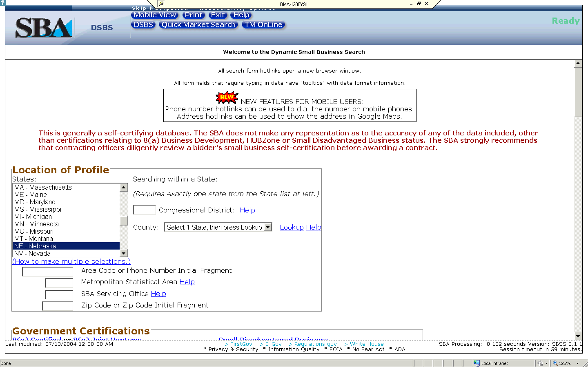
Dynamic Small Business Search

Slide 47
Summary of CFR Regulations
SBA Size Regulations 13 CFR Part 121
HUBZone Regulations 13 CFR 126.616
SBA Certificate of Competency 13 CFR 125.5
Service-Disabled Veteran 13 CFR 125.15(b)
8(a) and SDB Regulations 13 CFR 124.513
Small Disadvantaged Business 13 CFR 124.1002(f)
WOSB Program 13 CFR 127
SBA Prime Contracting 13 CFR 125.2
SBA Subcontracting 13 CFR 125.3
Notes:
47
47

Slide 48
Types of SBA Contacts and Offices
A. SBA Government Contracting Area Offices
1. SBA Procurement Center Representatives (PCRs)
2. SBA Commercial Market Representatives (CMRs)
B. SBA District Offices
1. Business Opportunity Specialists (BOS)
C. SBA Regional Offices
D. SBA Headquarters
Notes:
48
48

Slide 49
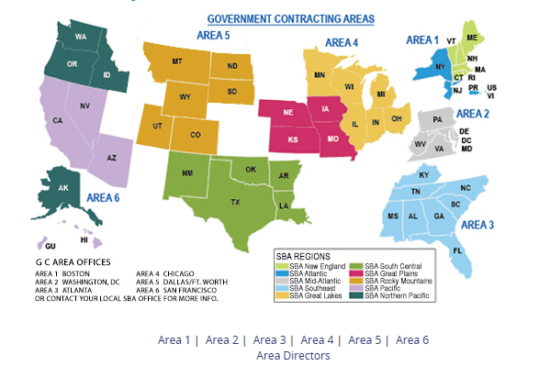
Six SBA Government Contracting Areas at hyperlink: https://www.sba.gov/content/pcr-directory

Slide 50
A. SBA Quick Reference - SBA Area Offices
1. Size protests (with recertification) FAR 19.302
13 CFR 121.1001
13 CFR 121.1010
2. Locating nearest SBA staffer FAR 19.4
3. Certificate of Competency FAR 19.6
13 CFR 125.5
4. COC Limitations on Subcontracting Compliance
FAR 19.601
13 CFR 125.6(f)
5. Receiving copies subcontracting plans
FAR 19.705-6

Slide 51
B. SBA Quick Reference - SBA Procurement Center Representatives (PCRs)
FAR 19.402 Small Business Administration procurement center representatives. (a)(1) The SBA may assign one or more procurement center representatives to any contracting activity or contract administration office to carry out SBA policies and programs…
(2) If a SBA procurement center representative is not assigned to the procuring activity or contract administration office, contact the SBA Office of Government Contracting Area Office…..
(b) Upon their request and subject to applicable acquisition and security regulations, contracting officers shall give SBA procurement center representatives….access to all reasonably obtainable contract….

Slide 52
B. SBA Quick Reference SBA PCRs, cont.
1. SBA PCR coordination records FAR 19..501(b)
13 CFR 125.2
2. Small business set-aside appeals FAR 19.505
13 CFR 125.2(b)(7)
3. HUBZone set-aside appeals FAR 19.1305
FAR 19.1306
13 CFR 126.61
4. SDVOSB set-aside appeal FAR 19.1405
FAR 19.1406
13 CFR 125.22
5. Reporting bundling to SBA (MATOCs) FAR 19.202-1(e)(1)
13 CFR 125.2
6. SBA subcontracting plan reviews-copies FAR 19.705-5(3)
13 CFR 125.2(b)(6)(iii)
FAR 19.705-6(c)
13 CFR 125.2(b)(6)(iii)(C)
7. SBA subcontracting program review FAR 19.707(4)
13 CFR 125.2(b)(6)(iii)(C)
8. Small business TFD FAR 49.402-3 (e)(4))
(Termination for default)
9. Surveillance review of agency contracting

Slide 53
Small Business Coordination Forms Sent To SBA PCRs
 | Agency | Form | Title
1 | Commerce | CD 570 | Small Business Set-aside Review
2 | Defense | 2579 | Small Business Coordination Record
3 | Energy | 4220.2 | Small Business Review Form
4 | GSA | 2689 | Small Business Analysis Record
5 | HHS | 653 | Small Business Review Form
6 | Homeland Security | 700-22 | Small Business Review Form
7 | Interior | 1886 | Acquisition Screening and Review Form
8 | Labor | DL1-2004 | Small Business Procurement Determination
9 | NASA | NF 1787 | Small Business Review Sheet
10 | State | DS-1910 | Small Business Clearance Form
11 | Transportation | 4250 | Small Business Program Review Form
12 | USDA | AD-1205 | Small Business Program – Procurement Review
13 | VA | 2268 | Procurement Request Review For Small Business…

Slide 54
Document that you have provided SBA Area Directors with copies of subcontracting plans
19.705-6 Postaward responsibilities of the contracting officer. …:
Notifying the SBA of the award by sending a copy of the award document to the Area Director, Office of Government Contracting, in the SBA area office where the contract will be performed.
(c) Giving to the SBA procurement center representative….a copy of—
(1) Any subcontracting plan submitted in response to a sealed bid solicitation; and
(2) The final negotiated subcontracting plan that was incorporated into a negotiated contract or contract modification.
(d) Notifying the SBA procurement center representative…. of the opportunity to review subcontracting plans in connection with contract modifications.

Slide 55
C. SBA Quick Reference - SBA Commercial Market Representatives (CMRs) link at: https://www.sba.gov/content/cmr-directory
Prime contractor portfolio management 13 CFR 125.3
Reviews of subcontracting plan holders 13 CFR 125.3
Matchmaking 13 CFR 125.3
SBA SUB-Net link at: http://www.sba.gov/content/sub-net
SBA Subcontracting Opportunities Directory link at: http://www.sba.gov/subcontracting-directory
“SBLO Handbook” link at: http://www.sba.gov/content/small-business-liaison-officer-handbook

Slide 56
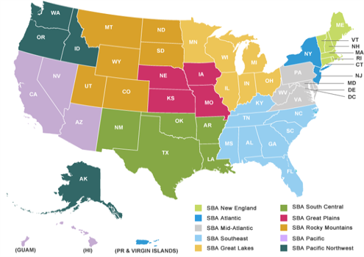
D. SBA Quick Reference – SBA Regional and District Offices
Link to district offices at: http://www.sba.gov/about-offices-list/3

Slide 57
D. SBA Quick Reference - SBA District Offices, cont.
To locate SBA 8(a) business development servicing office, check Dynamic Small Business Search at the link: http://dsbs.sba.gov/dsbs/search/dsp_dsbs.cfm and then local resources at the link http://www.sba.gov/tools/local-assistance/districtoffices

Slide 58
E. SBA Quick Reference - SBA Headquarters
1. HUBZone status protests FAR 19.306
13 CFR 126.801
2. NAICS code appeal FAR 19.30 3
13 CFR 121.1103
3. Non-manufacturer rule waivers FAR 19.102(f)(1)-(7)
13 CFR 121.1204
4. SDVOSB status protest FAR 19.307
13 CFR 125.23
5. WOSB Program status protest FAR 19.308/13 CFR 1275.600

Slide 59
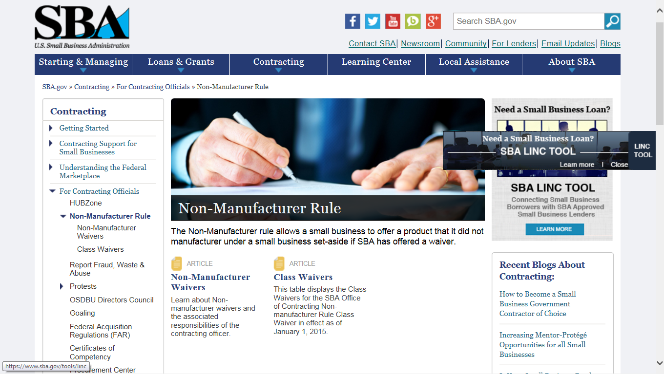
FAR 19.102 (f ): No class waiver to NMR? Check out an individual waiver*

Slide 60
B. A waiver for a set-aside is not needed when: 1. One small business manufacturer: * Small business set-aside 2. Small business manufacturer, brand specific of any dollar size with FAR 6 justification: * Small business set-aside 3. Large business, brand specific (or brand equivalent) requirement $25,000 or less with FAR 6: * Small business set-aside C. GSA schedule: Use the closest code listed on the schedule. Then same as above if no class waiver. D. Exception to “NMR” if procurement $25,000 or less.* (FAR 19.102 (f)(7)(B)) *note: THE far HAS NOT BEEN UPDATED TO AGREE WITH THE sba’S CHANGE IN maY 2016 TO $150k OR LESS IN 13 cfr 125.6
A. If you find no class waivers, an SBA individual waiver to the Nonmanufacturer Rule (NMR) may help you to achieve small business goals if*:

Slide 61
NMR Program Office
The preferred and most expeditious method for asking questions and submitting waiver requests is by e-mail to nmrwaivers@sba.gov.

Slide 62
SBA 1st First Wednesday Virtual Learning 2017
Find your PCR at https://www.sba.gov/content/pcr-directory

